Slide 1
Exploratory Aviation Delay and Reviews Analysis
TEAM MEMBERS:
Prateek Chourasia
Riya Patni
Nishchal Nagar
Under the guidance of
Prof. Juan C Rodriguez

Slide 2
Project Objective
What causes delays in flights?
Build a model that can predict the delay based on such factors.
Test the model for accuracy.
Perform text-analysis on user reviews to get a sense of common-topics.
Combine all of the above to develop a sound recommender system.

Slide 3
Motivation
Help the airline companies understand what impacts their performance
Help the users plan ahead of time by predicting the delays on chosen routes
Help users understand which airport suits them better based on preferences
Understand the common topics that reviewers talk about by analyzing text reviews.

Slide 4
Data Sources
Three Datasets:
Flights Data - Origin, Destination, DepDelay, Time, Carrier, Cancellation, etc.
Weather Data - Time, wind, precipitation, visibility, location, etc.
User Reviews Data - Carrier, time, review, rating, class, author_details, etc.

Slide 5
Tech Stack
Apache Spark
Apache Spark (Scala) - Data Preprocessing for Machine Learning and Delay analysis
Pyspark - Data preprocessing for Text Analysis
SparkMLlib - Machine Learning, Text Analysis
SparkSQL - Analysis of results
R Programming and Tableau - Visualizations

Slide 6
Architecture Design
Weather Data
Combining Weather and Flight Data
Module 1 – Prediction System(Random Forest/ GBT Model)
Prediction
Flight Data
ReviewsData
Preprocessing the data
Clean Data
Module 2 – Text Analysis (TF/IDF & LDA Model)
Topics
Notes:
Only JFK, LAX and SFO airports were taken into consideration as Origin airport.
Our model is extensible to many airports, but due to weather data and other constraint we have only restricted ourselves to some of the major airports of USA.
We are using a static data-set source for flight data for years 2006,2007 and 2008.
Source :
Weather Data was taken for stations near JFK, LAX and SFO airports.
Weather Data was taken for 2006, 2007 and 2008.
The data was taken from static source
Source :

Slide 7
Design Goals
Scalable Design
Generic System
Automated Workflow
Fault Tolerance
Modularity

Slide 8
Analyzing Delays
Visualize delays

Slide 9
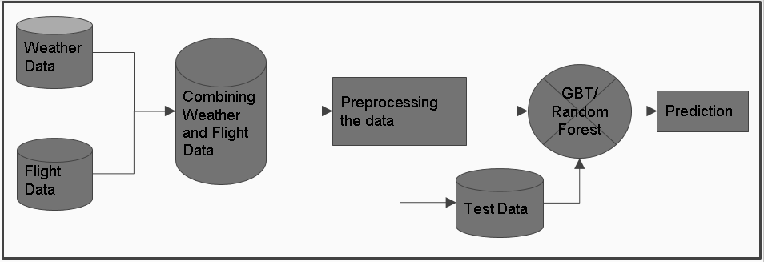
Design Pipeline for Module 1 Delay Prediction Model

Slide 10
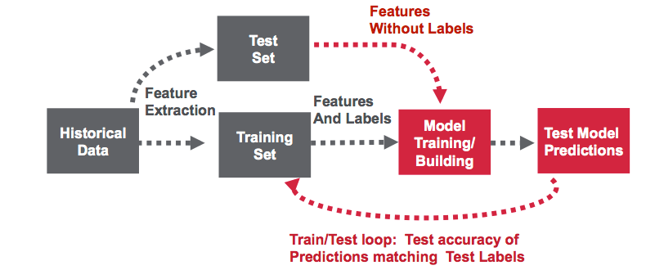
How prediction models work

Slide 11
Model
Recommender System designed for predicting flight delays consists of following Stages
Stage 1: Combining Weather and Flight Dataset
Stage 2: Preprocessing the Combined dataset
Stage 3: Applying different machine learning models and training them using training data
Stage 4: Testing the obtained model on test dataset

Slide 12
Stage 1: Combining the dataset
Stage 1 in the process comprises of combining the weather and flight dataset.
For training purposes we have combined 2006 and 2007 weather and flight dataset, and for testing purpose we are combining 2008’s weather and flight dataset.

Slide 13
Stage 2: Preprocessing
After the required dataset have been combined , it is followed by preprocessing of the dataset.
Preprocessing Step comprises of extracting the desired columns from the desired dataset, in our case we have taken 10 columns from the combined dataset for processing
Preprocessing step in our model also consists of labeling the training set as flight being delayed(1) or flight on schedule(0)
Note: We have considered DepartureDealy > 15min as delay in flight.

Slide 14
Step 3: Applying different ML Models
After preparing the Training and testing data ,we need to choose different Machine Learning models to train and fine-tune them in order to obtain the desired result
We have used Gradient Boosting Trees and Random Forests model for designing our recommender system.
Notes:
Random Forest Model:-
0.256

Slide 15
Step 4 : Testing the ML Model
After ML Model has been trained using training data, we need to check its accuracy using test data.
The test data/ unseen data is fed to the trained network and test error is calculated determining the accuracy of the model.
In our case, we have incrementally added the weather parameters to make our model more accurate and measuring its accuracy on the test data.
Results of our experiment are documented on the next slide.

Slide 16
Prediction Accuracy Results
Model | FlightData | FlightData + WindSpeed | FlightData + WindSpeed + Visibility | FlightData + WindSpeed+Visibility+Precipitation
Gradient Boosted Tree Model | 73.8% | 74.02% | 74.8% | 76.5%
Random Forest Model | 71.8% | 73.5% | 73.93% | 74.2%

Slide 17
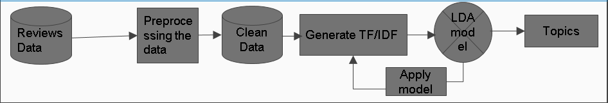
Design Pipeline for Module 2 Text Analysis

Slide 18
Understanding TF/IDF and LDA
Intuition behind TF/IDF
Intuition behind Latent Dirichlet Allocation (LDA)

Slide 19
Text Analysis
Pre process reviews data
Tokenize, remove stopwords, special characters and words of short length
Generate TF-IDF model
Apply LDA Clustering
Combine topics with original dataset
Analyze interesting topics

Slide 20
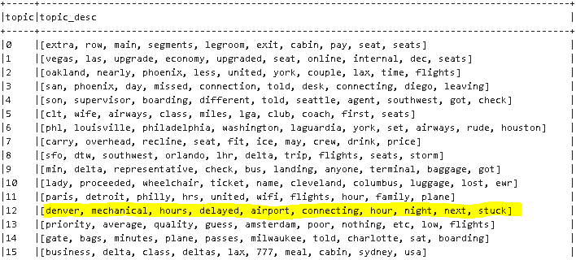

Slide 21
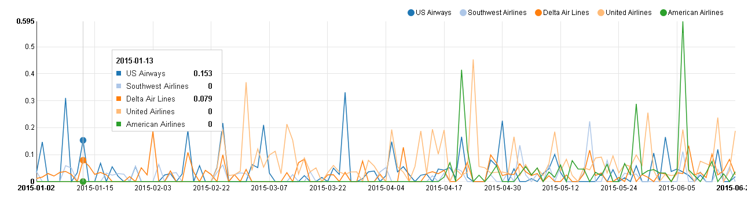
Analyzing results

Slide 22
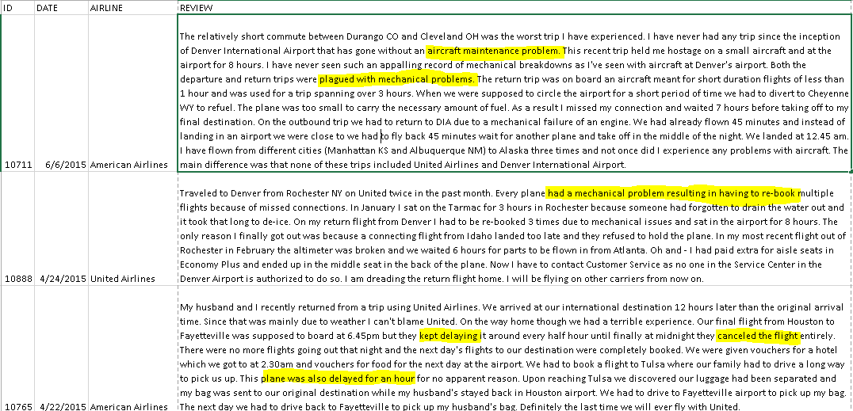

Slide 23
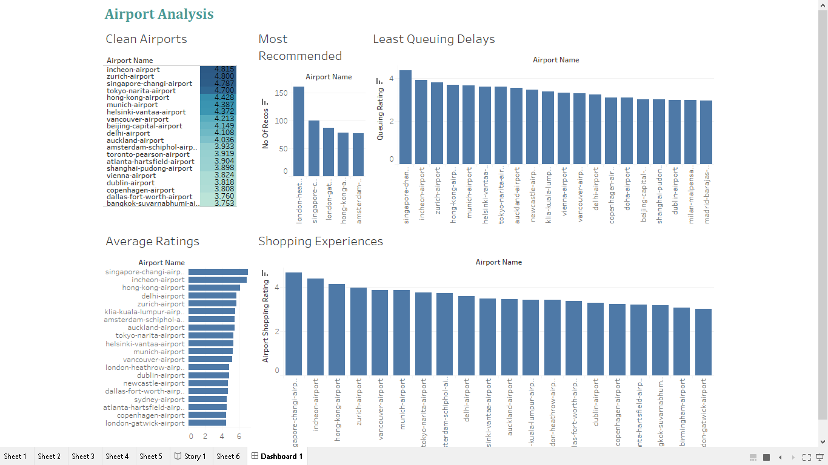
Analysis of Airport Reviews

Slide 24
Conclusion
Flight delays are caused due to a combination of factors such as origin, destination, carrier, airTime, time of the year etc.
Weather factors such as precipitation, visibility and wind speed also impact the flight schedules
GBT model gave more accurate results in delay prediction
Prediction can be improved by incorporating more factors such as manufacturer, aircraft design, age of aircraft etc.

Slide 25
Conclusion
Based on user reviews, airports and airlines can be rated based on different factors such as cleanliness, seat comfort, shopping experience, value for money etc.
Text analysis helped us find out the most common topics that decide a user review.
Using a prediction model on these topics, we can predict the user rating analyzing a new review.

Slide 26
Future Work
Using this model on live streamed flight and weather data.
Improve accuracy of prediction by including additional parameters about aircraft design.
Automating the training process on streamed data after fixed intervals, to improve accuracy.
Scale-up the model to analyze all the airlines from all sources and destinations across United States.

Slide 27
Thank You!

